Slide 1
Pipeline and Steps
Input with
Raw Data
Data Trimming
(Trim-Galore 0.6.5)
Map to Genome
(STAR 2.7.3a)
Count Reads
(HTseq Count 0.6.1)
Extract gene counts (Avg counts>10)
Plots for DEGs
(Vennerable, ggplot2, ComplexHeatmap)
Call DEGs
(Deseq2)
GO Analysis
(David 6.8)

Slide 2
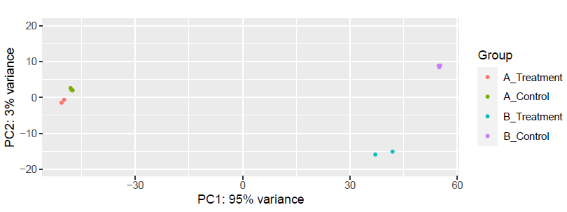
PCA Analysis of Samples

Slide 3
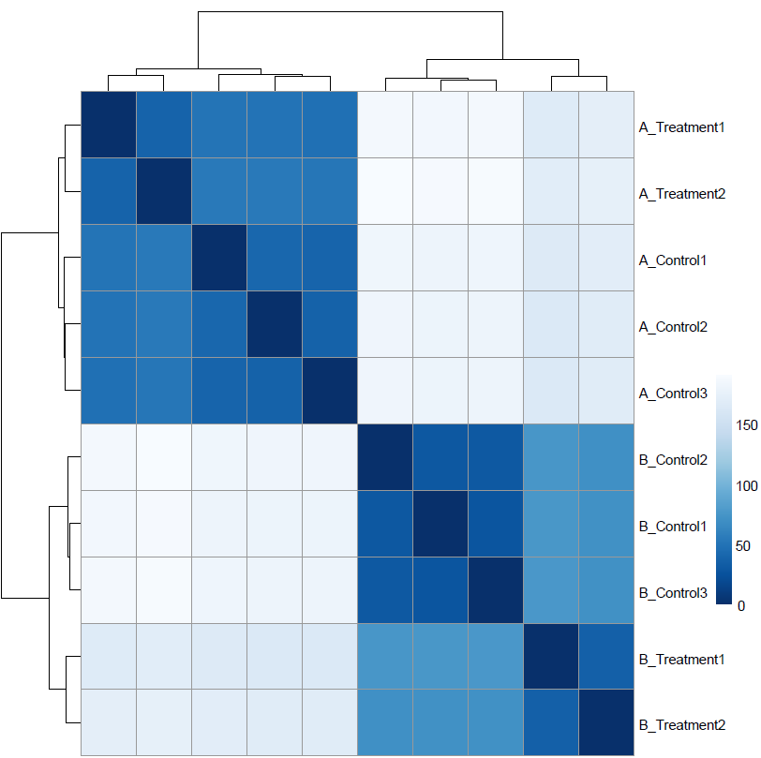
Sample Distance Heatmap Plot

Slide 4
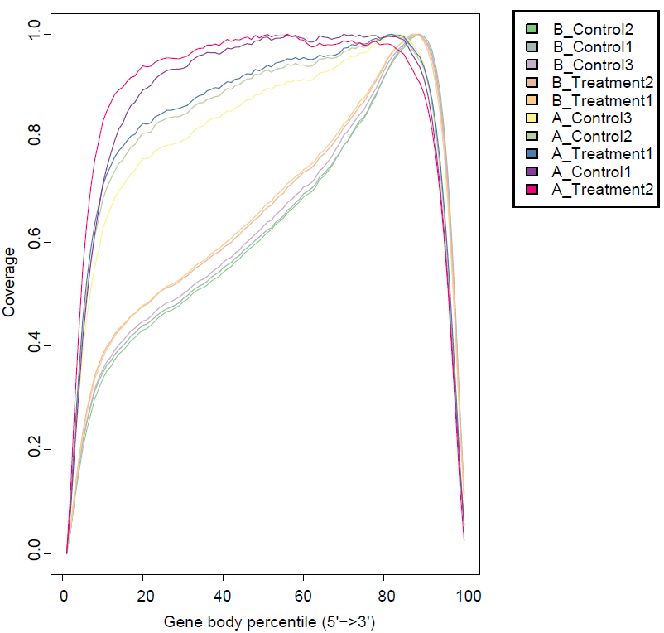
RSeQC Genbody Coverage Plot

Slide 5
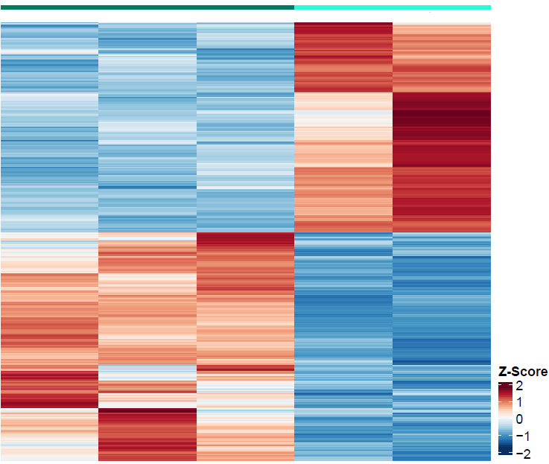
Heatmap for all DEGs
A_Control
A_Treatment

Slide 6
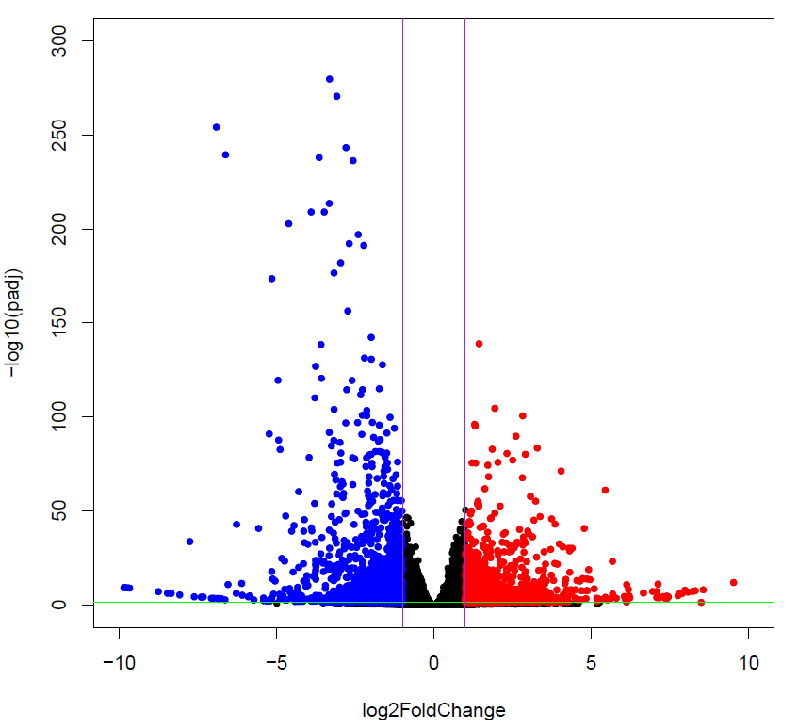
Volcano Plots (FDR<0.05 abs(Log2FC)>1)

Slide 7
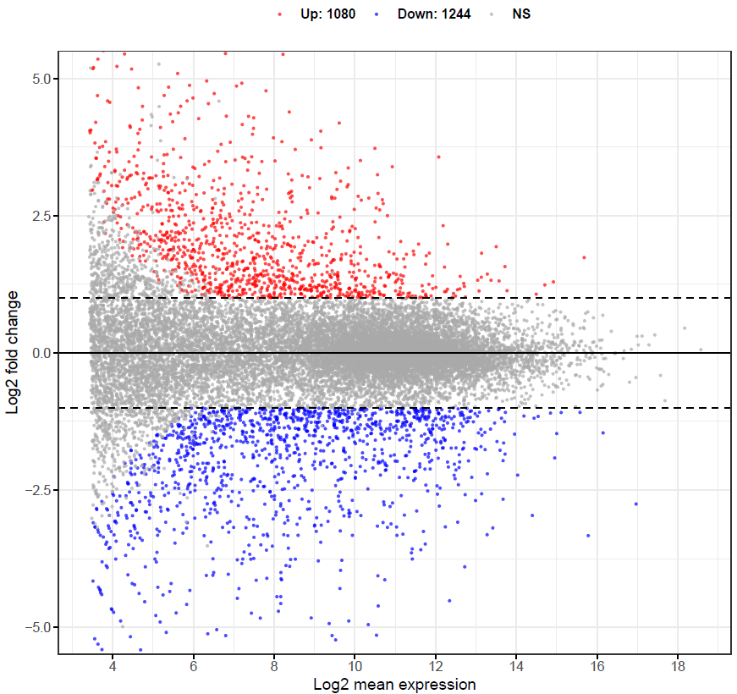
MA Plots (FDR<0.05 abs(Log2FC)>1)

Slide 8
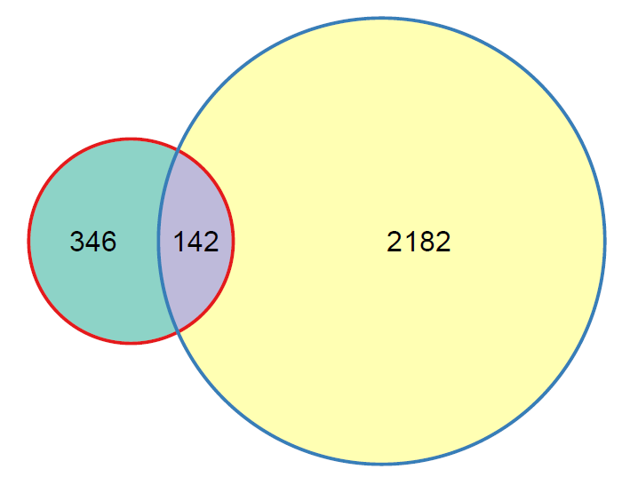
Venn Diagram
B
A
GO Term Analysis

Slide 9
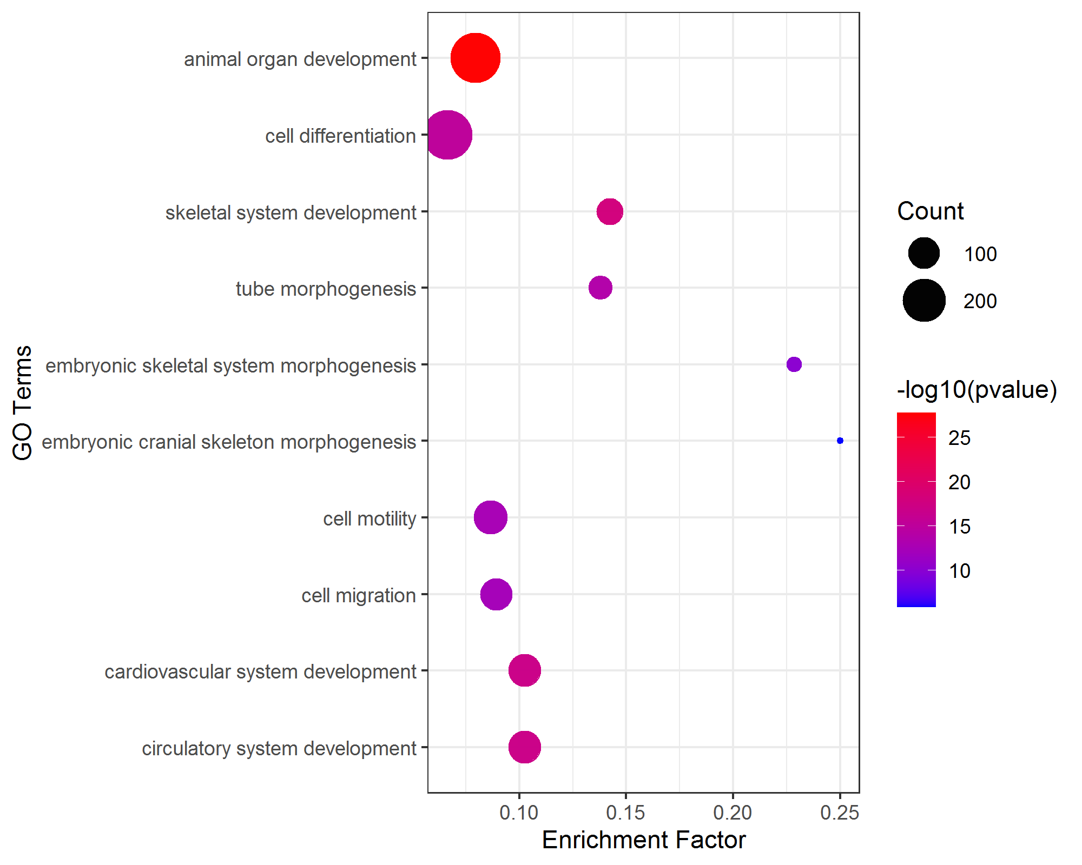
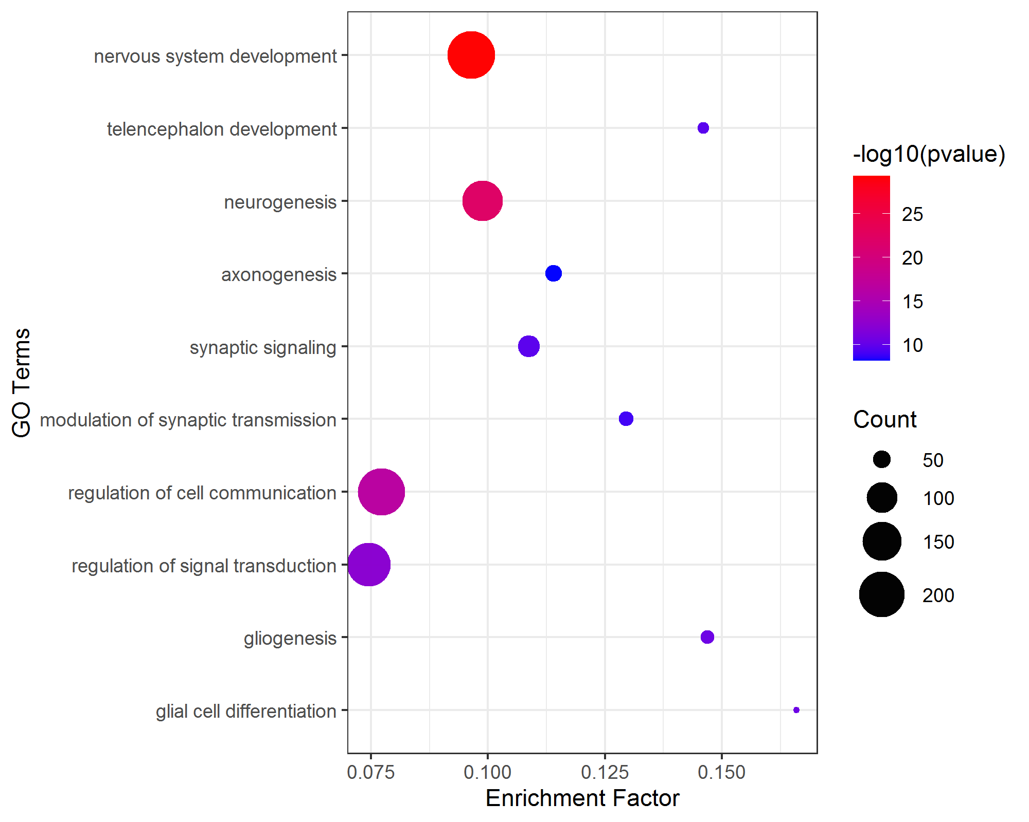
Bubble Plots
Up DEGs
Down DEGs

Slide 10
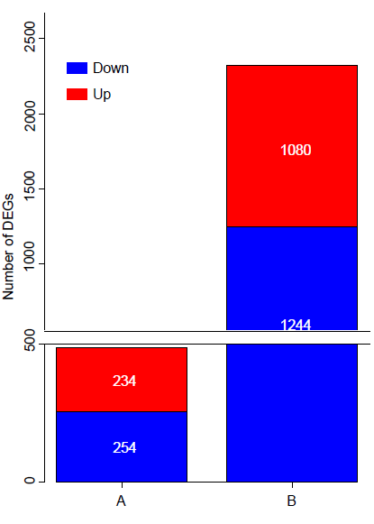
BarPlot

